Slide 1
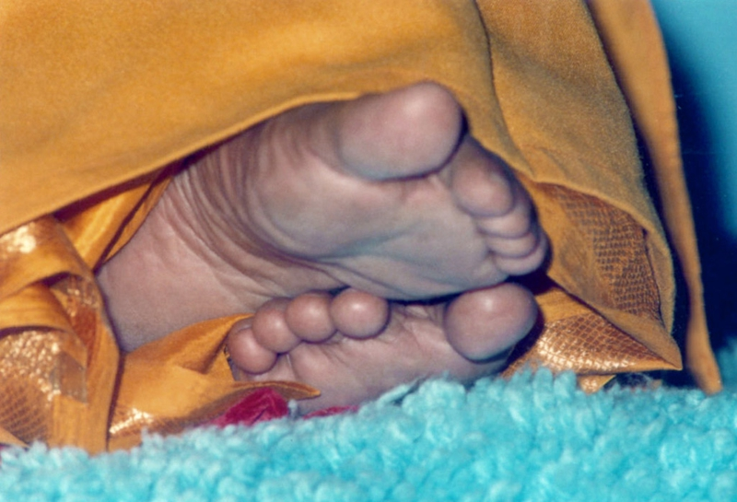
OFFERING OUR HUMBLE PRANAMS AT OUR MASTER ‘S DIVINE FEET

Slide 2
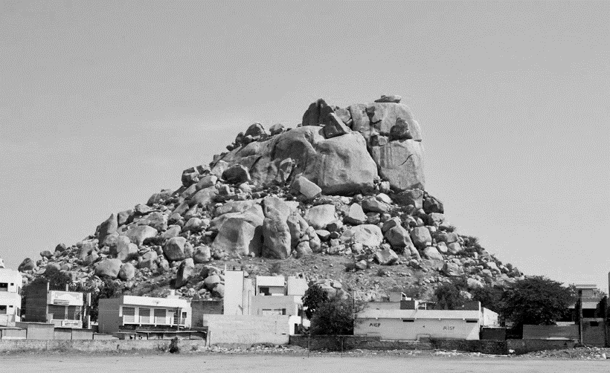
T H E S E R P E N T H I L L
Present picture of The Serpent Hill

Slide 3
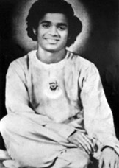
“ I belong to Apasthamba Suthra ;
I am of the Bharadwaja Gothra ;
I am Sai Baba ;
I have come to ward off all your troubles;
Keep your houses clean and pure. ”

Slide 4
The place “Uravakonda’’ derives it’s name from the hill that dominates the place,”Uragakonda”.
Uraga = Serpent
Konda = Hill

Slide 5
Uravakonda was lucky enough that Satyanarayana Raju himself has joined the High School accompanying his brother and the new telugu teacher.
Boys told each other that he was a fine Telugu writer, a good musician, genius in dance, wiser than his teacher.
Sathya soon became pet of the entire school. He was the leader of the school Prayer Group.
He was the best among the school scouts.

Slide 6
Sathya was the life and soul of the school dramatics
Sri Tammi Raju ,the teacher in charge , once asked Sathya to write and direct a play in Telugu.
Sathya entitled the play as “CHEPPINATTU CHESTHARA?”, “Do deeds follow words?”, to put it in English.
The play was a great success. It had as its theme, the eternal sin of man , hypocrisy, not acting as he feels he should.

Slide 7
Sathya won the respect of the common man in Uravakonda through his divine miracles.
The missing Pen
The missing Jatka(Horse drawn cart)

Slide 8
March 8th, 1940 - The Scorpion Attack.
The belief of people .
Sukshma Sharira (Subtle Body).

Slide 9
A complete transformation of the personality.
Sathya demonstrated that he is beyond “Visha and Vishaya”, unaffected by poison or the objective world.

Slide 10
Sheshama Raju’s letter to Puttaparthi :
Informed the state of things in Uravakonda.
Informed the condition of Sathya .

Slide 11
Sathya becomes omnipresent:
Bhagavatham reciting Shastri.
Exorciser in uravakonda.
Exorciser in puttaparthi.

Slide 12
No cure for Sathya’s illness:
Sathya’s strange behaviour
Worry of Sathya’s parents
Sathya’s own philosophies

Slide 13
The Shakti worshippers torture
Sathya’s strange attitude
Sathya’s Parents shocking reactions

Slide 14
Bullock cart incident
Visit of Sri Krishnamachari (vakil) at Sathya’s house
Visit to Narasimha Swami temple to cure Sathya’s illness

Slide 15
23rd may,1940 incident.
Words of Sathya – “I am Sai Baba”.
Venkavadootha’s wish.

Slide 16
Government Officer-ardent worshipper of Shirdi Sai Baba.
Challenge to Sathya.
Sathya school life resumes

Slide 17
Thursdays at Uravakonda
Test to Sathya-Vedanta Sadhana
Invitations from Hospet by various officers- The Deputy Inspector of Schools, the health officer, some municipal councillors, few merchants , etc.

Slide 18
Satya’s omnipresence at Lord Virupaksha temple.
Sathya’s omnipotence – Cured a TB patient
20th October,1940 – The Avatar Declaration Day.

Slide 19
Sai Baba’s first bhajan.
The Photograph-Rock turning into an idol of Shirdi Sai Baba.
Return of Maya.
Baba’s return to Puttaparthi.

Slide 20
…JAI SAI RAM

